Slide 1
HYPOTHESIS TESTING

Slide 2
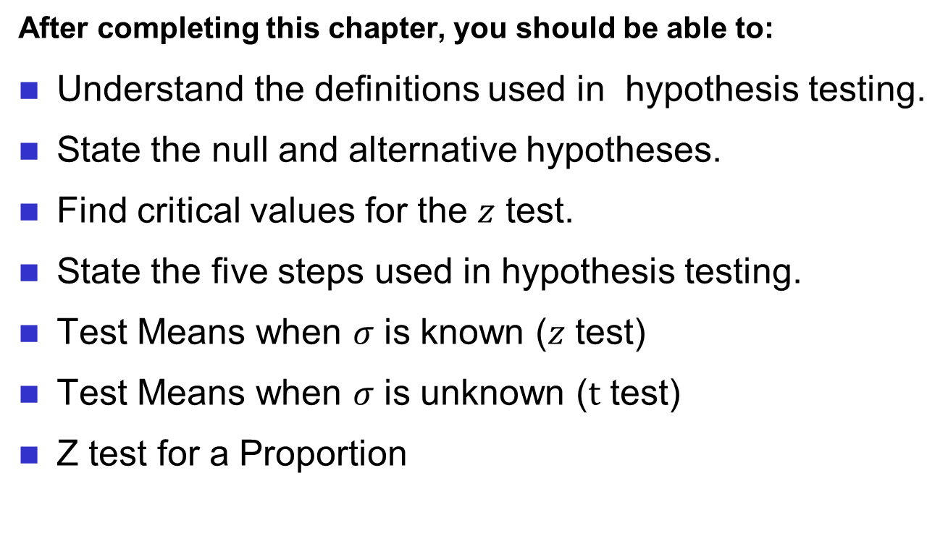
Learning Objectives
After completing this chapter, you should be able to:
Understand the definitions used in hypothesis testing.
State the null and alternative hypotheses.
Find critical values for the $z$ test.
State the five steps used in hypothesis testing.
Test Means when $σ$ is known ($z$ test)
Test Means when $σ$ is unknown ($t$ test)
Z test for a Proportion

Slide 3
Hypothesis Testing
Researchers are interested in answering many types of questions. For example,
Is new teaching technique better than traditional one?
Is vaccine can cure Covid-19 virus?
These types of questions can be addressed through statistical hypothesis testing.

Slide 4
Hypothesis Testing
Three methods used to test hypotheses:
The traditional method
The P-value method
The confidence interval method

Slide 5
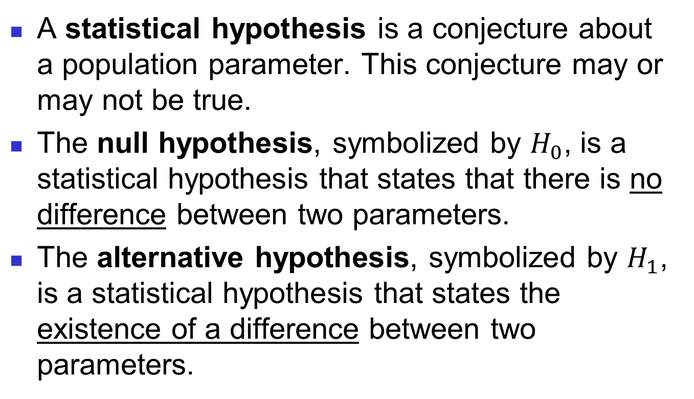
Hypothesis Testing (Traditional Method)
A statistical hypothesis is a conjecture about a population parameter. This conjecture may or may not be true.
The null hypothesis, symbolized by $H_{0}$, is a statistical hypothesis that states that there is no difference between two parameters.
The alternative hypothesis, symbolized by $H_{1}$, is a statistical hypothesis that states the existence of a difference between two parameters.

Slide 6
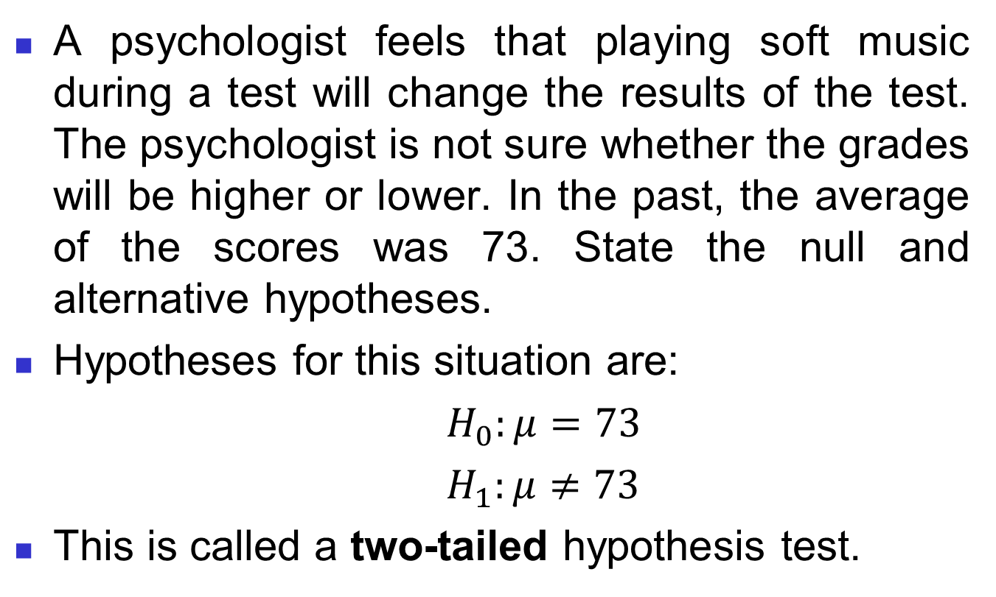
Example 1
A psychologist feels that playing soft music during a test will change the results of the test. The psychologist is not sure whether the grades will be higher or lower. In the past, the average of the scores was 73. State the null and alternative hypotheses.
Hypotheses for this situation are:
$H_{0}:μ=73$
$H_{1}:μ≠73$
This is called a two-tailed hypothesis test.

Slide 7
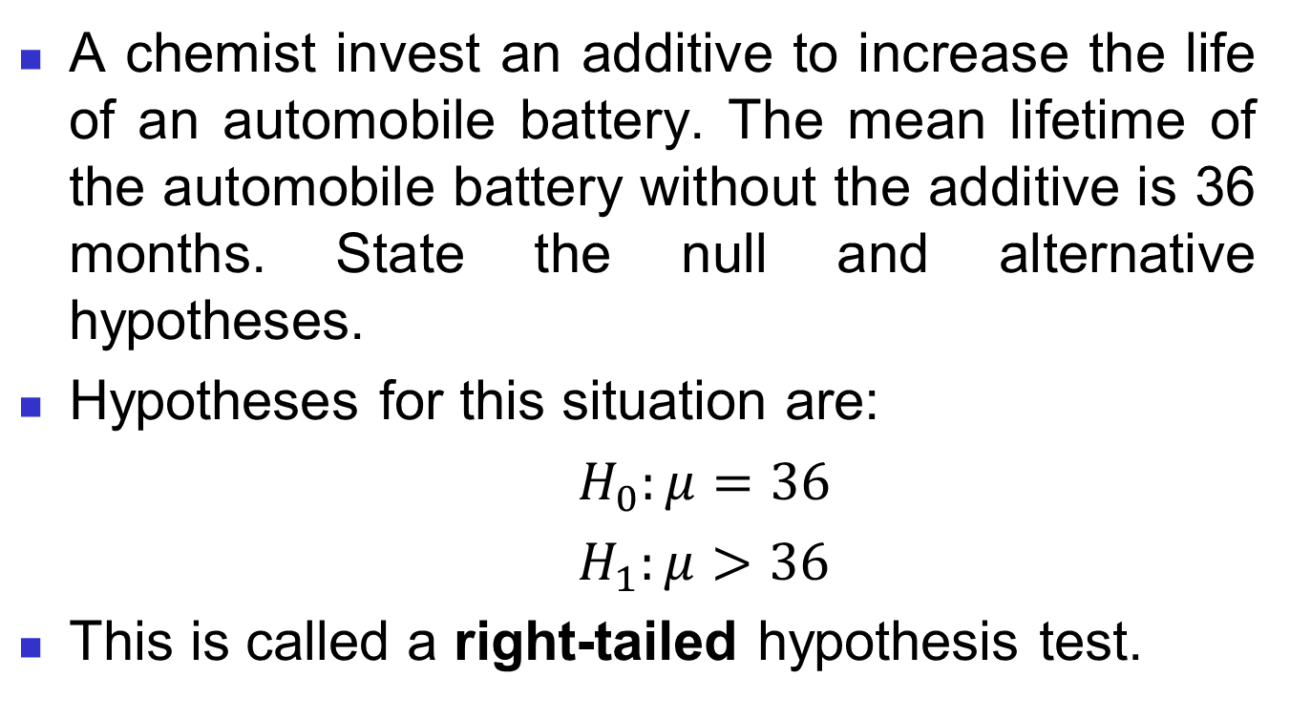
Example 2
A chemist invest an additive to increase the life of an automobile battery. The mean lifetime of the automobile battery without the additive is 36 months. State the null and alternative hypotheses.
Hypotheses for this situation are:
$H_{0}:μ=36$
$H_{1}:μ>36$
This is called a right-tailed hypothesis test.

Slide 8

Example 3
A contractor wishes to lower heating bills by using a special type of insulation in houses. If the average of the monthly heating bills is RM 78, her hypotheses about heating costs with the use of insulation are,
Hypotheses for this situation are:
$H_{0}:μ=78$
$H_{1}:μ<78$
This is called a left-tailed hypothesis test.

Slide 9
continue..
When researcher conducts a study, he or she generally looking for evidence to support a claim.
So, the claim should be stated as the alternative hypothesis or research hypothesis.

Slide 10
continue..
After stating the hypotheses, then design the study. Researcher selects the correct statistical test, choose an appropriate level of significance, and formulates a plan for conducting the study.
A statistical test uses the data obtained from a sample to make decision about whether the null hypothesis should be rejected.
The numerical value obtained from a statistical test is called the test value.

Slide 11
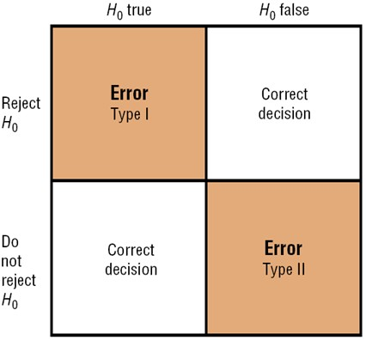
continue..
There are four possible outcomes in hypothesis-testing situation.

Slide 12
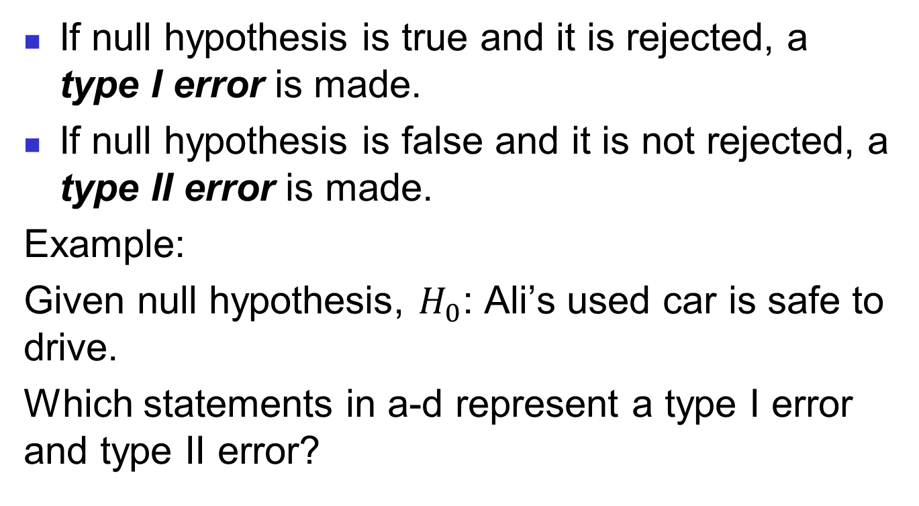
continue..
If null hypothesis is true and it is rejected, a type I error is made.
If null hypothesis is false and it is not rejected, a type II error is made.
Example:
Given null hypothesis, $H_{0}$: Ali’s used car is safe to drive.
Which statements in a-d represent a type I error and type II error?

Slide 13
Ali thinks that his car may be safe when, in fact, it is not safe.
Ali thinks that his car may be safe when, in fact, it is safe.
Ali thinks that his car may not be safe when, in fact, it is not safe.
Ali thinks that his car may not be safe when, in fact, it is safe.

Slide 14
Type I & II Error Relationship
Type I and Type II errors cannot happen at
the same time
A Type I error can only occur if H₀ is true
A Type II error can only occur if H₀ is false
If Type I error probability (α) , then
Type II error probability (β)

Slide 15
Factors Affecting Type II Error
All else equal,
β when the difference between hypothesized parameter and its true value
β when α
β when σ
β when n

Slide 16
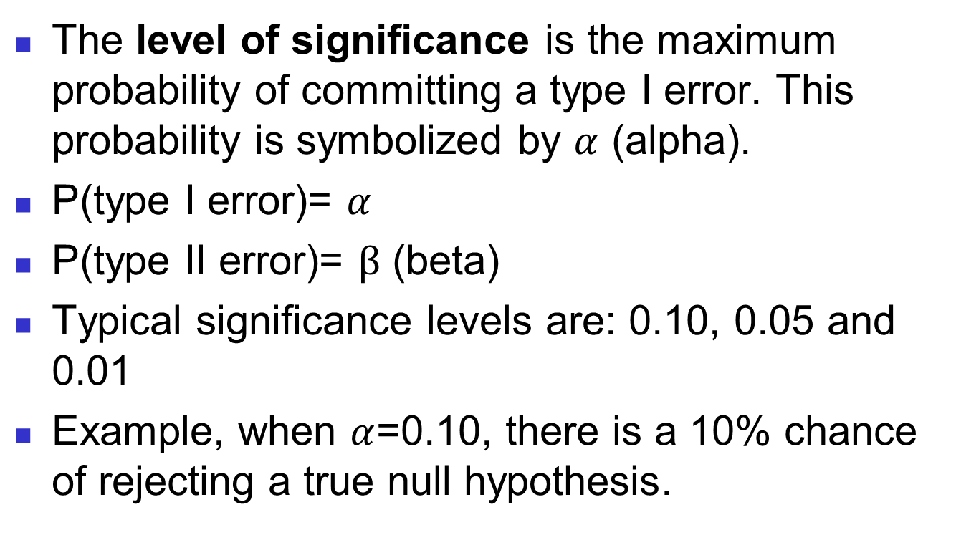
Level of Significance
The level of significance is the maximum probability of committing a type I error. This probability is symbolized by $α$ (alpha).
P(type I error)= $α$
P(type II error)= $β$ (beta)
Typical significance levels are: 0.10, 0.05 and 0.01
Example, when $α$=0.10, there is a 10% chance of rejecting a true null hypothesis.

Slide 17
Critical Value
The critical value (C.V), separates the critical region from the noncritical region.
The critical (rejection) region is the range of values of the test value that indicates there is a significant difference and that the null hypothesis should be rejected.
The noncritical (nonrejection) region is the range of values of the test value that indicates that the difference was probably due to chance and that the null hypothesis should not be rejected.

Slide 18
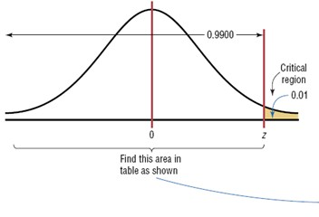
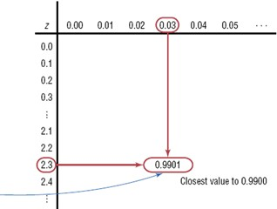

Example: Finding the critical value for $α$=0.01 (Right-Tailed Test)

Slide 19
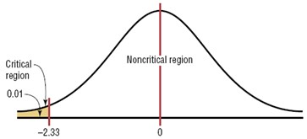

Example: Finding the critical value for $α$=0.01 (Left-Tailed Test)
Because of symmetry, z=-2.33 for $α$=0.01

Slide 20
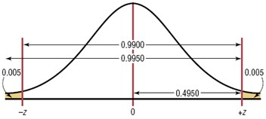
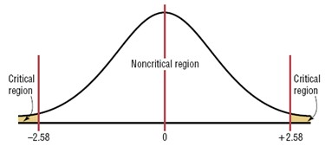

Example: Finding the critical value for $α$=0.01 (Two-Tailed Test)
Z= $±2.58$

Slide 21
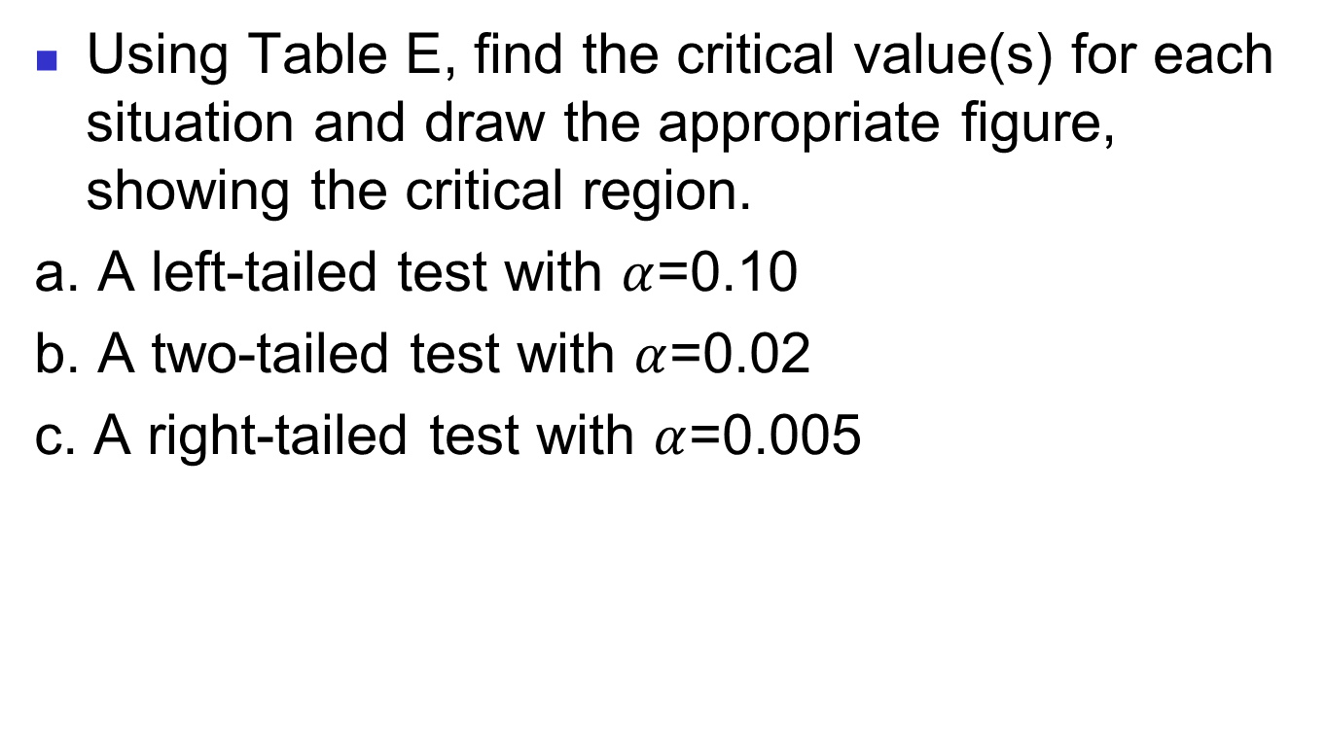
Activity 1
Using Table E, find the critical value(s) for each situation and draw the appropriate figure, showing the critical region.
a. A left-tailed test with $α$=0.10
b. A two-tailed test with $α$=0.02
c. A right-tailed test with $α$=0.005

Slide 22
Steps of Traditional Method
Steps in solving hypothesis-testing (Traditional Method)
State the hypotheses and identify the claim.
Find the critical value from the statistical table.
Compute the test value.
Make the decision to reject or not to reject the null hypothesis.
Write the conclusion

Slide 23
Z Test of Hypothesis for the Mean (σ Known)
Convert sample statistic ( ) to a Z_{STAT} test statistic
X
Hypothesis
Tests for μ
σ Known
σ Known
σ Unknown
σ Unknown
(Z test)
(t test)
The test statistic is:

Slide 24
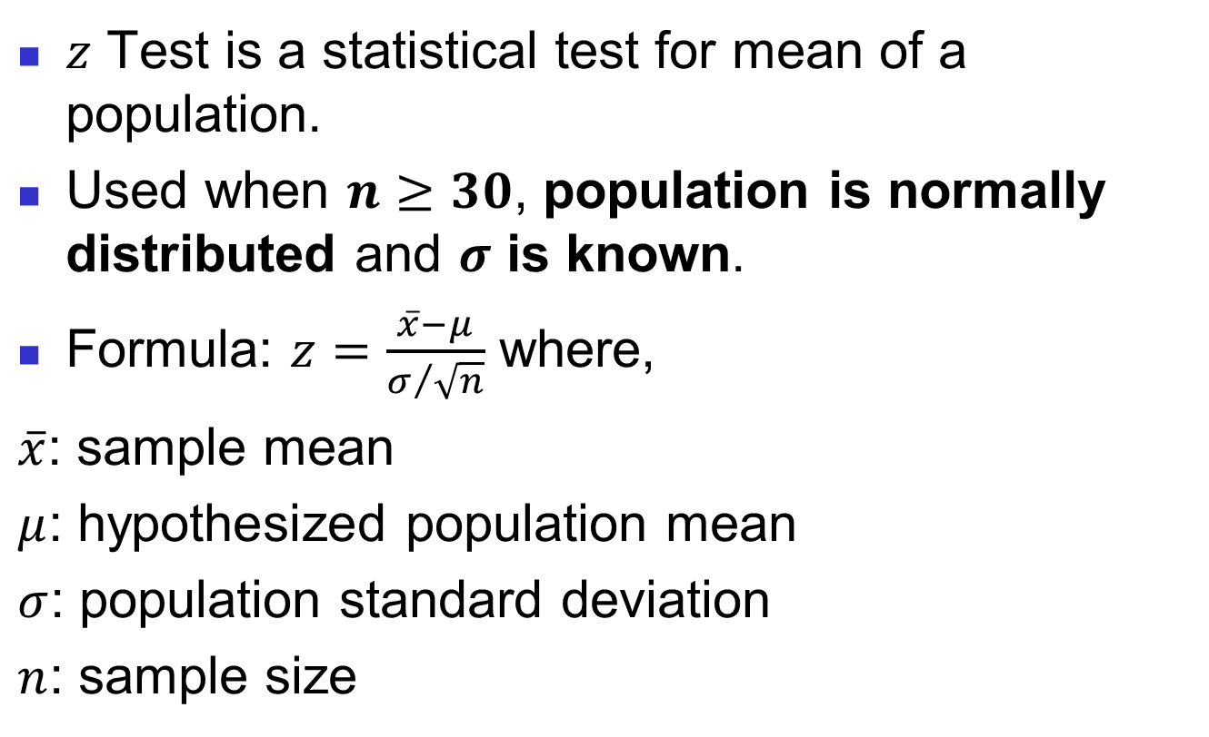

$Z−$ Test for Mean
$z$ Test is a statistical test for mean of a population.
Used when $n≥30$, population is normally distributed and $σ$ is known.
Formula: $z=\frac{\overline{x}−μ}{σ/{\sqrt{n}}}$ where,
$\overline{x}$: sample mean
$μ$: hypothesized population mean
$σ$: population standard deviation
$n$: sample size

Slide 25
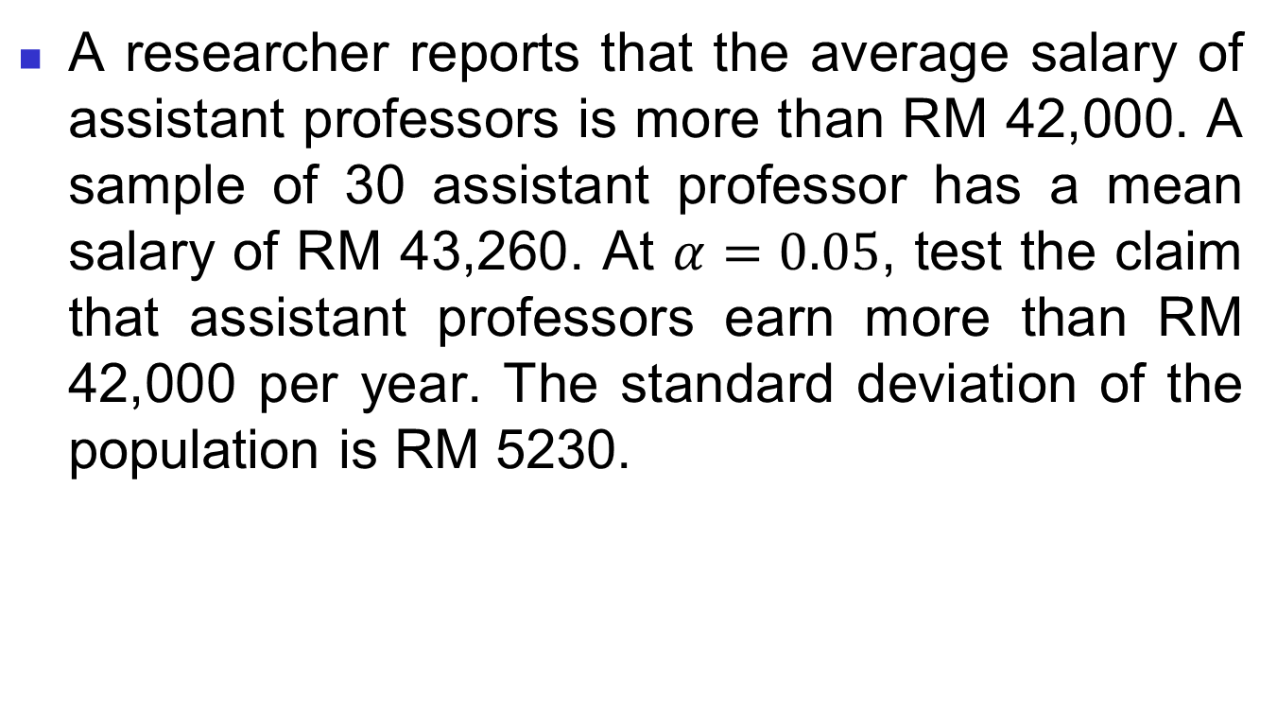

Example $Z−$Test
A researcher reports that the average salary of assistant professors is more than RM 42,000. A sample of 30 assistant professor has a mean salary of RM 43,260. At $α=0.05$, test the claim that assistant professors earn more than RM 42,000 per year. The standard deviation of the population is RM 5230.

Slide 26
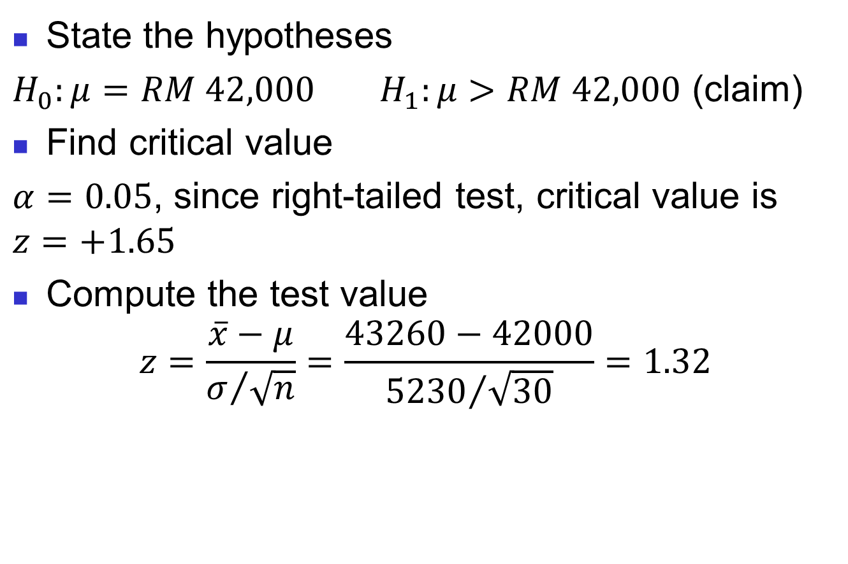
Solution
State the hypotheses
$H_{0}:μ=RM 42,000$ $H_{1}:μ>RM 42,000$ (claim)
Find critical value
$α=0.05$, since right-tailed test, critical value is $z=+1.65$
Compute the test value
$$z=\frac{\overline{x}−μ}{σ/{\sqrt{n}}}=\frac{43260−42000}{{5230}/{\sqrt{30}}}=1.32$$

Slide 27
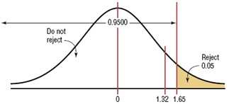
Continue..
Make decision (Reject or fail to reject)
Since test value =1.32 < critical value=1.65, fail to reject null hypothesis.
There is not enough evidence to support the claim that assistant professors earn more on average than RM 42,000 per year.

Slide 28
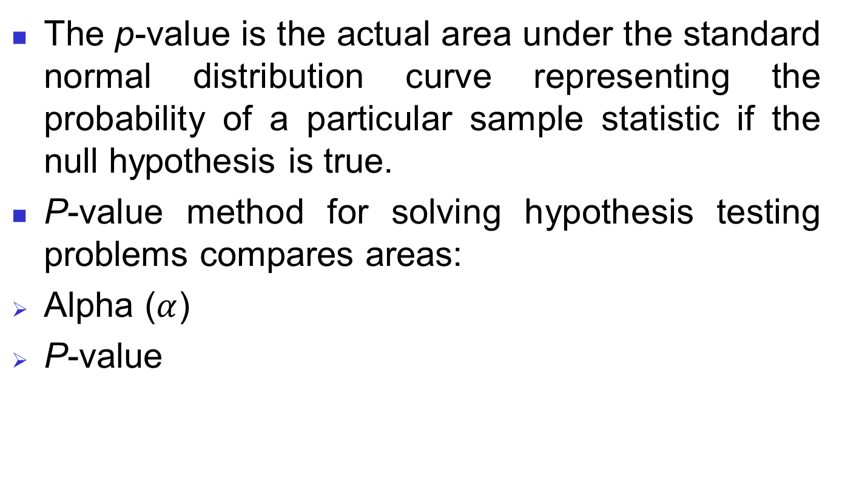
Hypothesis Testing (P-value Method)
The p-value is the actual area under the standard normal distribution curve representing the probability of a particular sample statistic if the null hypothesis is true.
P-value method for solving hypothesis testing problems compares areas:
Alpha ($α$)
P-value
Compare the p-value with α
If p-value < α , reject H₀
If p-value ≥ α , do not reject H₀

Slide 29
Steps of P-value
Solving hypothesis-testing problems using p-value method
State the hypotheses and identify the claim.
Compare the test value.
Find the p-value.
Make the decision (reject or fail to reject)
Conclusion

Slide 30
Example p-value method
A researcher wishes to test the claim that the average cost of tuition and fees at a four-year public college is greater than $5700. She selects a random sample of 36 students and finds the mean to be $5950. The population standard deviation is $659. Is there evidence to support the claim at a 0.05? Use the p-value method.

Slide 31
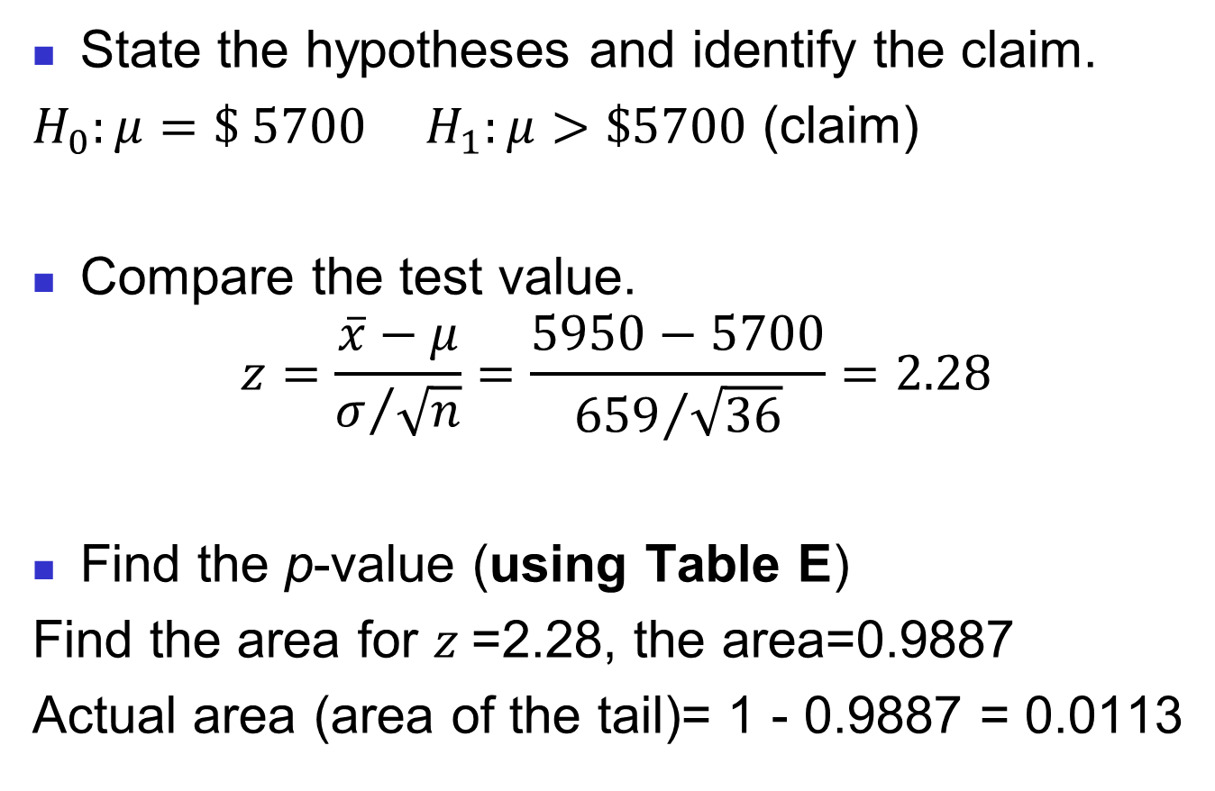
Solution
State the hypotheses and identify the claim.
$H_{0}:μ=\$ 5700$ $H_{1}:μ>\$5700$ (claim)
Compare the test value.
$$z=\frac{\overline{x}−μ}{σ/{\sqrt{n}}}=\frac{5950−5700}{{659}/{\sqrt{36}}}=2.28$$
Find the p-value (using Table E)
Find the area for $z$=2.28, the area=0.9887
Actual area (area of the tail)= 1 - 0.9887 = 0.0113

Slide 32
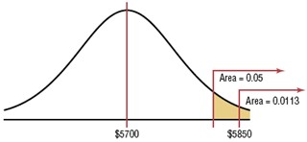
Make the decision (reject or fail to reject)
Since the p-value = 0.0113 < α =0.05, reject the null hypothesis.
Conclusion
There is enough evidence to support the claim that the tuition and fees at four-year public colleges are greater than $5700.

Slide 33
Hypothesis Testing (Confidence Interval Method)
When the null hypothesis is rejected in a hypothesis-testing, the confidence interval for the mean using the same level of significance will not contain the hypothesized mean.
When the null hypothesis is not rejected, the confidence interval computed using the same level of significance will contain the hypothesized mean.

Slide 34
Example C.I method
Sugar is packed in 5-pound bags. An inspector suspects the bags may not contain 5 pounds. A sample of 50 bags produces a mean of 4.6 pounds and a standard deviation of 0.7 pound. Is there enough evidence to conclude that the bags do not contain 5 pounds as stated as α=0.05? Also find 95% confidence interval of the true mean.

Slide 35
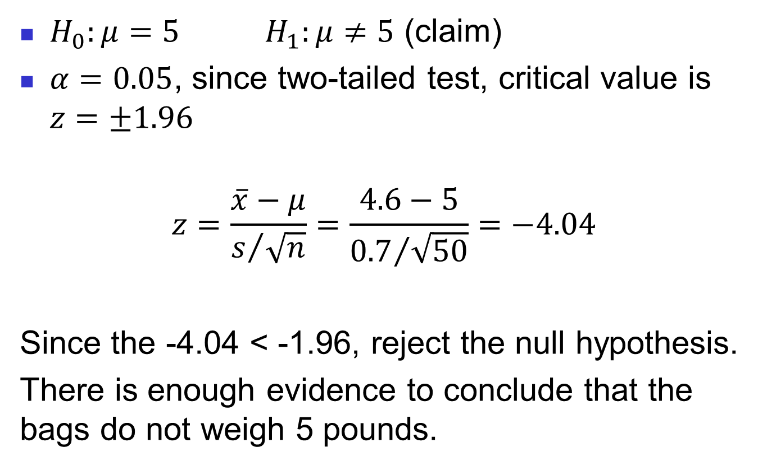
Solution
$H_{0}:μ=5$ $H_{1}:μ≠5$ (claim)
$α=0.05$, since two-tailed test, critical value is $z=±1.96$
$$z=\frac{\overline{x}−μ}{s/{\sqrt{n}}}=\frac{4.6−5}{{0.7}/{\sqrt{50}}}=−4.04$$
Since the -4.04 < -1.96, reject the null hypothesis.
There is enough evidence to conclude that the bags do not weigh 5 pounds.

Slide 36
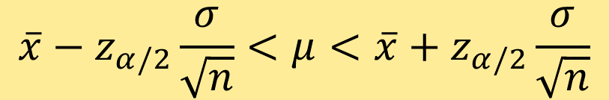

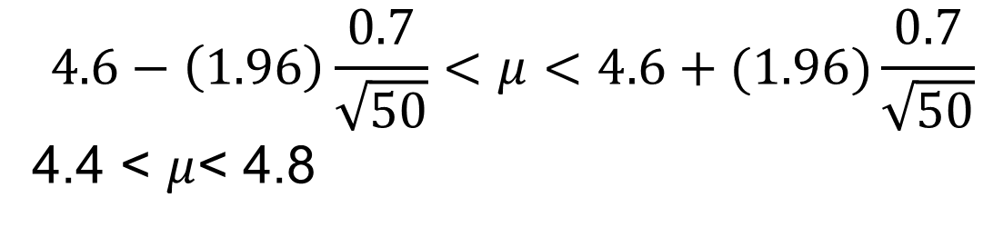
The 95% confidence interval:
The 95% confidence interval of $μ$ does not contain the hypothesized value $μ$=5. Thus, we reject.
$${\overline{x}−z}_{α/2}\frac{σ}{\sqrt{n}}<μ<{\overline{x}+z}_{α/2}\frac{σ}{\sqrt{n}}$$
$$4.6−\left(1.96\right)\frac{0.7}{\sqrt{50}}<μ<4.6+(1.96)\frac{0.7}{\sqrt{50}}$$
4.4 < $μ$< 4.8

Slide 37
t Test of Hypothesis for the Mean (σ Unknown)
Convert sample statistic ( ) to a t_{STAT} test statistic
X
Hypothesis
Tests for μ
Hypothesis
Tests for μ
Hypothesis
Tests for μ
σ Known
σ Known
σ Known
σ Known
σ Known
σ Known
σ Unknown
σ Unknown
σ Unknown
σ Unknown
σ Unknown
σ Unknown
(Z test)
(Z test)
(Z test)
(t test)
(t test)
(t test)
The test statistic is:
The test statistic is:
The test statistic is:

Slide 38
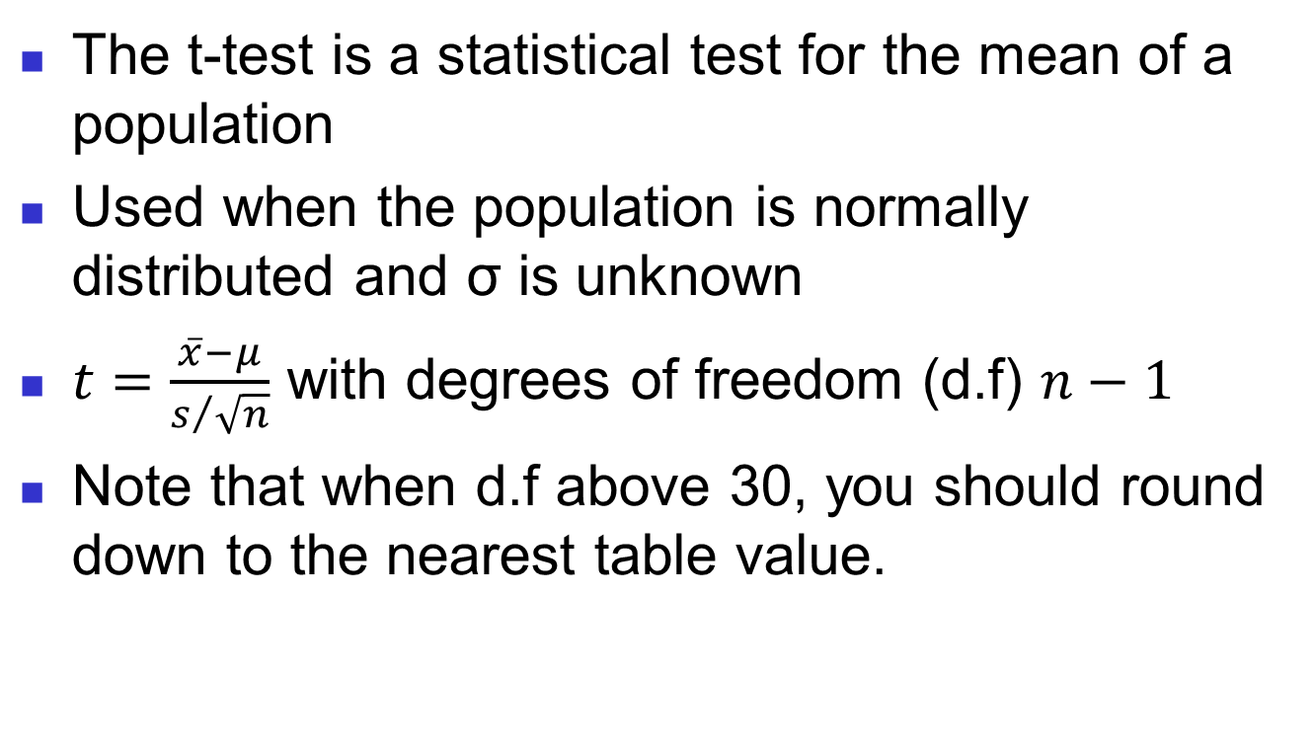

Test Means when $σ$ is unknown ($t$- test)
The t-test is a statistical test for the mean of a population
Used when the population is normally distributed and σ is unknown
$t=\frac{\overline{x}−μ}{s/{\sqrt{n}}}$ with degrees of freedom (d.f) $n−1$
Note that when d.f above 30, you should round down to the nearest table value.

Slide 39
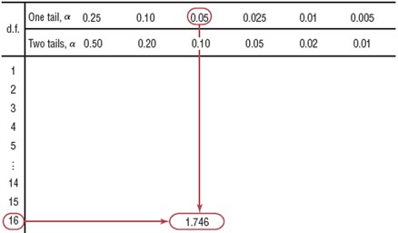
Example 1
Find the critical t value for α=0.05 with d.f=16 for a right-tailed t test. (Table F)
Find the 0.05 column in the top row and 16 in the left-hand column.
Critical t-value= 1.746

Slide 40
Example 2
Find the critical t-value for α=0.01 with d.f=22 for a left-tailed t-test.
Find the 0.01 column in the one tail row and 22 in the d.f column.
Critical t-value= -2.508

Slide 41
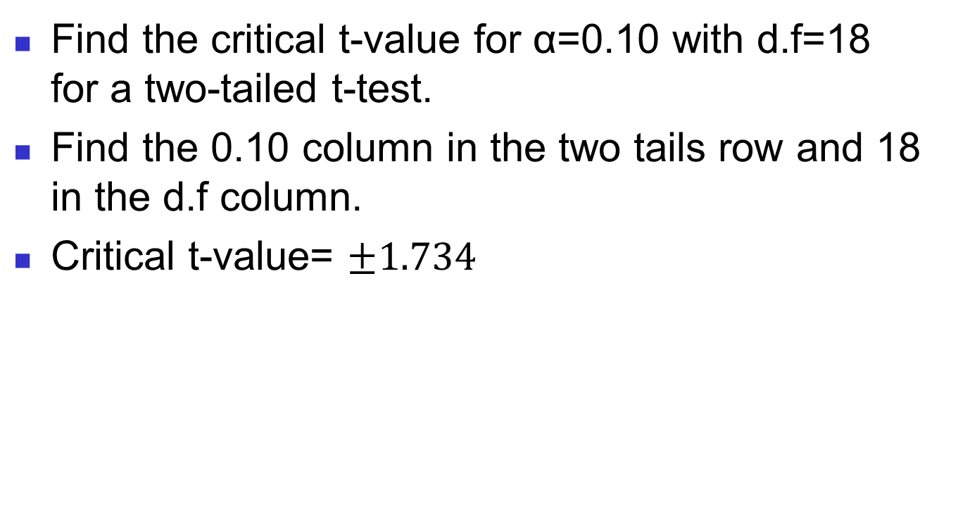
Example 3
Find the critical t-value for α=0.10 with d.f=18 for a two-tailed t-test.
Find the 0.10 column in the two tails row and 18 in the d.f column.
Critical t-value= $±1.734$

Slide 42
Hypothesis Testing t-test (Traditional Method)
A medical investigation claims that the average number infections per week at a hospital in Town XX is 16.3. A random sample of 10 weeks had a mean number of 17.7 infections. The sample standard deviation is 1.8. Is there enough evidence to reject the investigator’s claim at α=0.05?

Slide 43
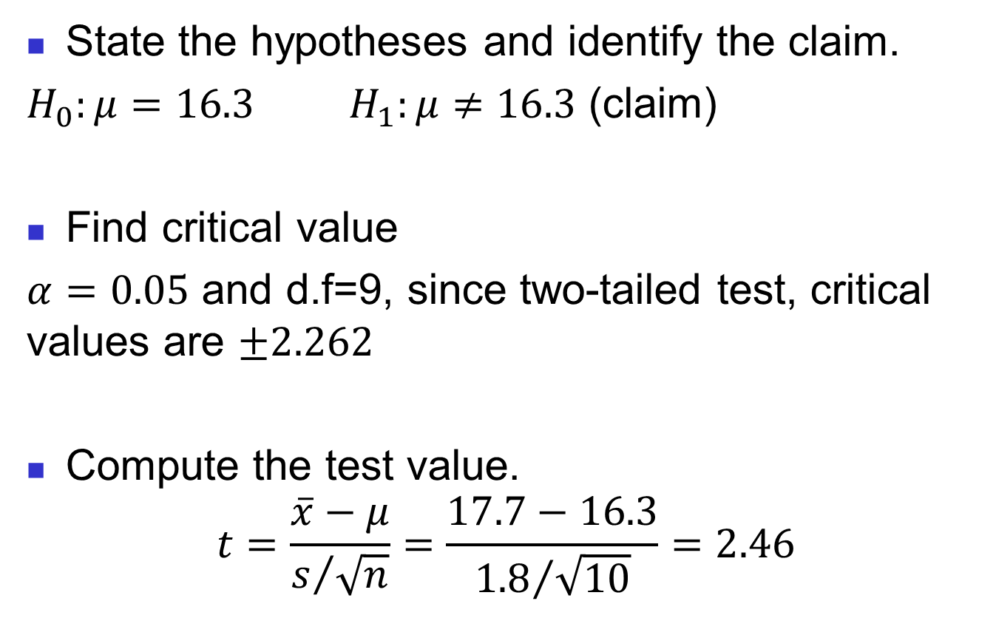
Solution
State the hypotheses and identify the claim.
$H_{0}:μ=16.3$ $H_{1}:μ≠16.3$ (claim)
Find critical value
$α=0.05$ and d.f=9, since two-tailed test, critical values are $±2.262$
Compute the test value.
$$t=\frac{\overline{x}−μ}{s/{\sqrt{n}}}=\frac{17.7−16.3}{{1.8}/{\sqrt{10}}}=2.46$$

Slide 44
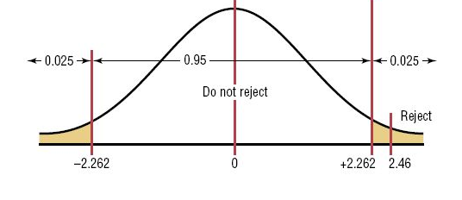
Make decision (Reject or fail to reject)
Since test value =2.46 > critical value=2.262, reject the null hypothesis.
There is enough evidence to reject the claim that the average number of infections is 16.3.

Slide 45
Hypothesis Testing: t-test (P-value Method)
A physician claims that joggers’ maximal volume oxygen uptake is greater than the average of all adults. A sample of 15 joggers has a mean of 40.6ml/kg and a standard deviation of 6ml/kg. If the average of all adults is 36.7ml/kg, is there enough evidence to support the physician’s claim at α=0.05?

Slide 46
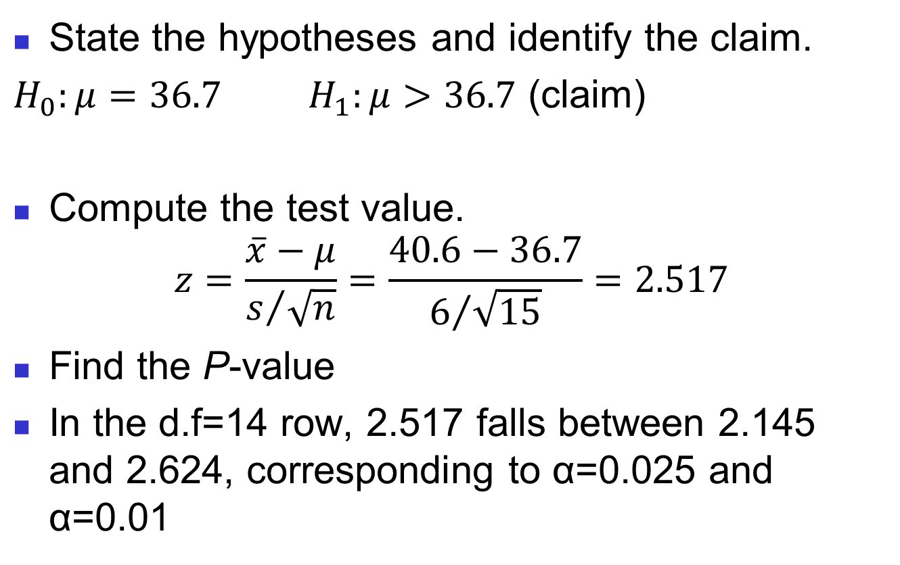
Solution
State the hypotheses and identify the claim.
$H_{0}:μ=36.7$ $H_{1}:μ>36.7$ (claim)
Compute the test value.
$$z=\frac{\overline{x}−μ}{s/{\sqrt{n}}}=\frac{40.6−36.7}{6/{\sqrt{15}}}=2.517$$
Find the P-value
In the d.f=14 row, 2.517 falls between 2.145 and 2.624, corresponding to α=0.025 and α=0.01

Slide 47
Thus, the p-value is somewhere between 0.01 and 0.025, since this is a one tailed test.
Decision: Reject null hypothesis since p-value <0.05.
Conclusion: There is enough evidence to support the claim that the joggers’ maximal volume oxygen uptake is greater than 36.7 ml/kg.

Slide 48
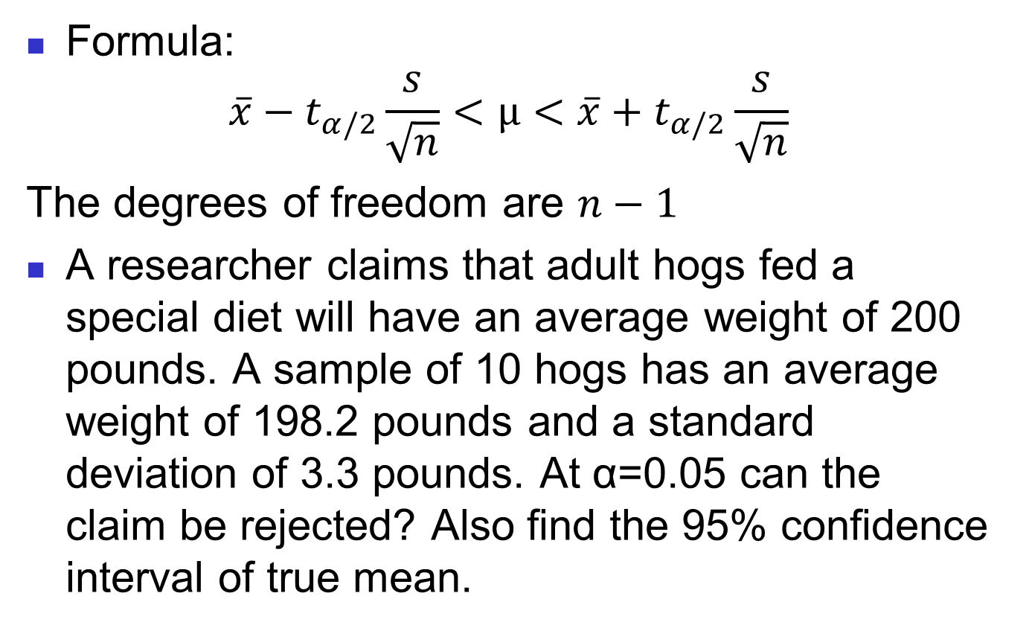
Hypothesis Testing: t-test (Confidence interval Method)
Formula:
$${\overline{x}−t}_{α/2}\frac{s}{\sqrt{n}}<μ<{\overline{x}+t}_{α/2}\frac{s}{\sqrt{n}}$$
The degrees of freedom are $n−1$
A researcher claims that adult hogs fed a special diet will have an average weight of 200 pounds. A sample of 10 hogs has an average weight of 198.2 pounds and a standard deviation of 3.3 pounds. At α=0.05 can the claim be rejected? Also find the 95% confidence interval of true mean.

Slide 49
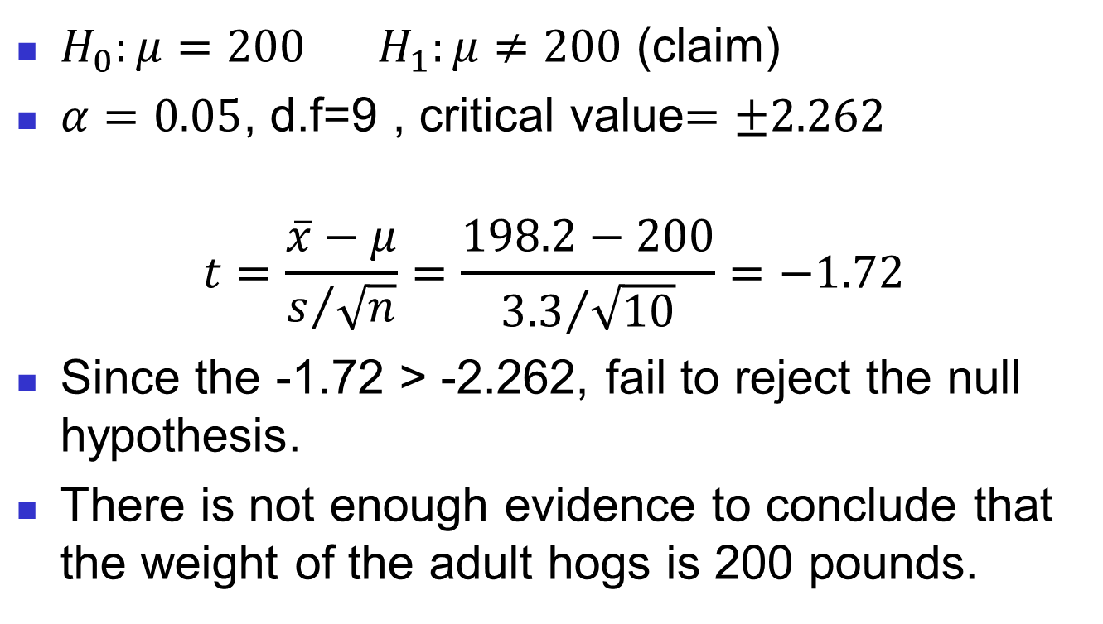
Solution
$H_{0}:μ=200$ $H_{1}:μ≠200$ (claim)
$α=0.05$, d.f=9 , critical value$=±2.262$
$$t=\frac{\overline{x}−μ}{s/{\sqrt{n}}}=\frac{198.2−200}{{3.3}/{\sqrt{10}}}=−1.72$$
Since the -1.72 > -2.262, fail to reject the null hypothesis.
There is not enough evidence to conclude that the weight of the adult hogs is 200 pounds.

Slide 50
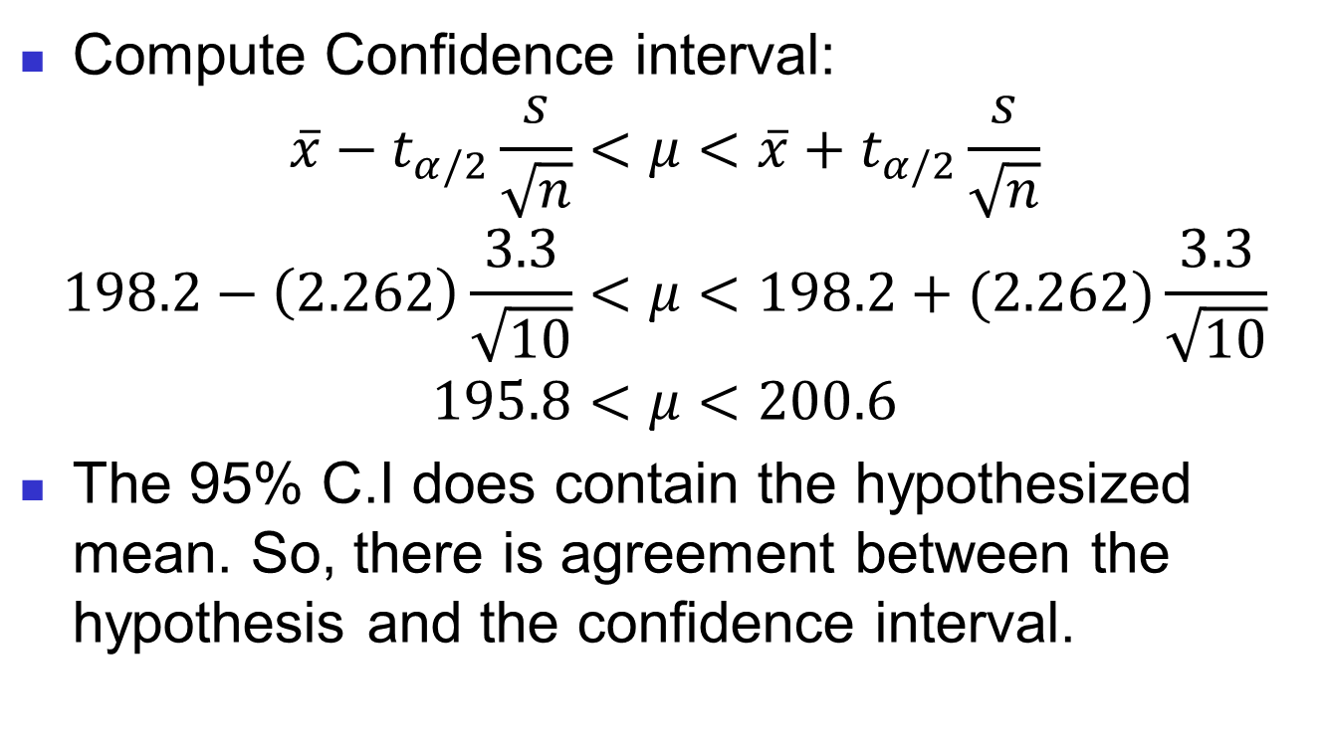
Compute Confidence interval:
$${\overline{x}−t}_{α/2}\frac{s}{\sqrt{n}}<μ<{\overline{x}+t}_{α/2}\frac{s}{\sqrt{n}}$$
$$198.2−\left(2.262\right)\frac{3.3}{\sqrt{10}}<μ<198.2+(2.262)\frac{3.3}{\sqrt{10}}$$
$$195.8<μ<200.6$$
The 95% C.I does contain the hypothesized mean. So, there is agreement between the hypothesis and the confidence interval.

Slide 51
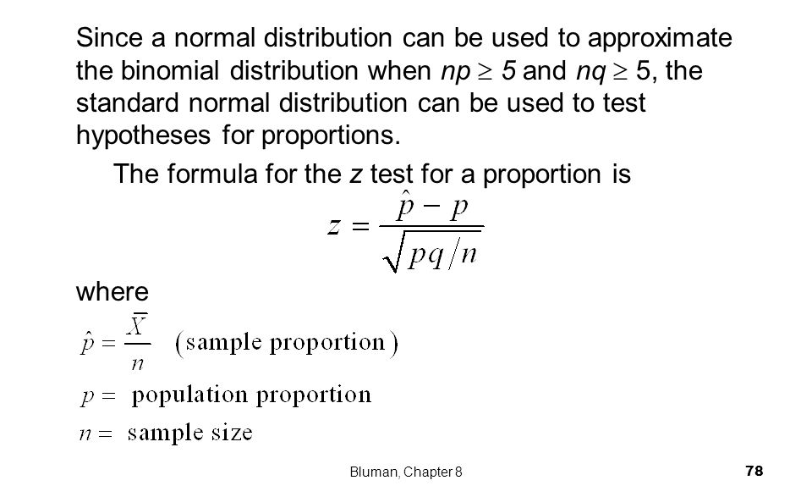
Z -Test for a Proportion

Slide 52
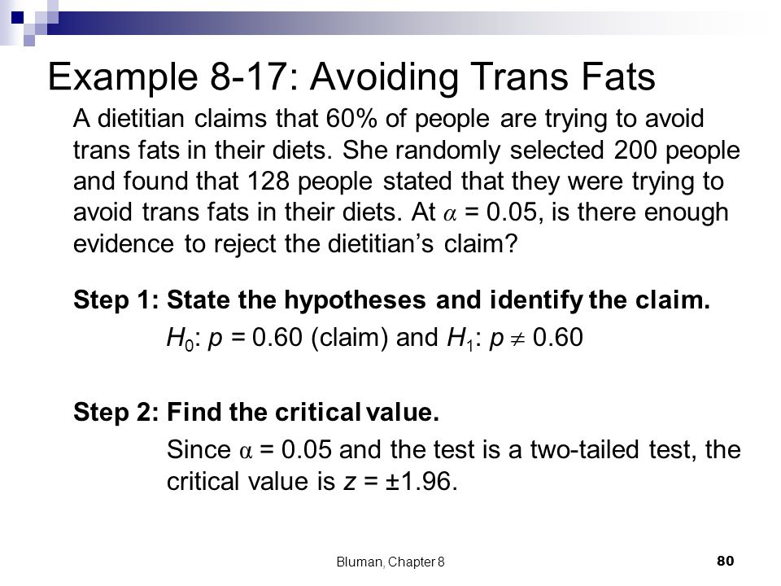
Hypothesis Testing: Z-test for Proportion (Traditional Method)

Slide 53
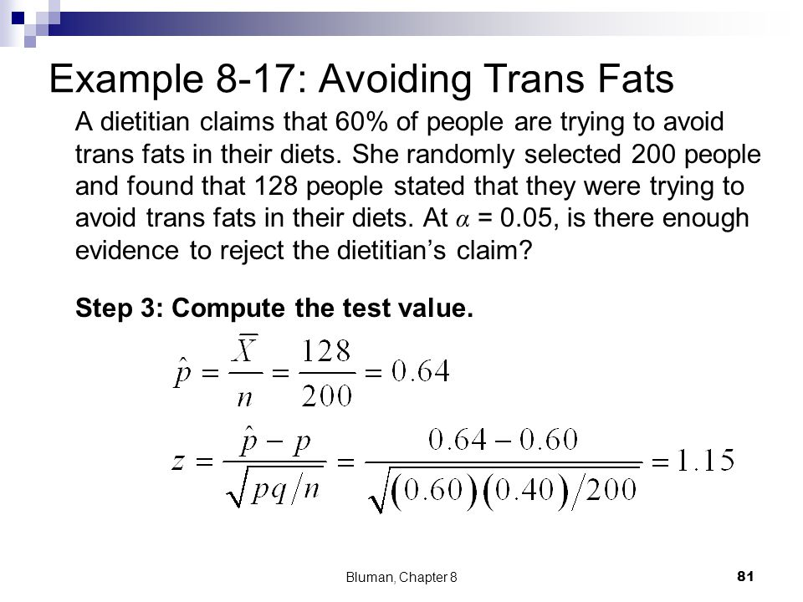
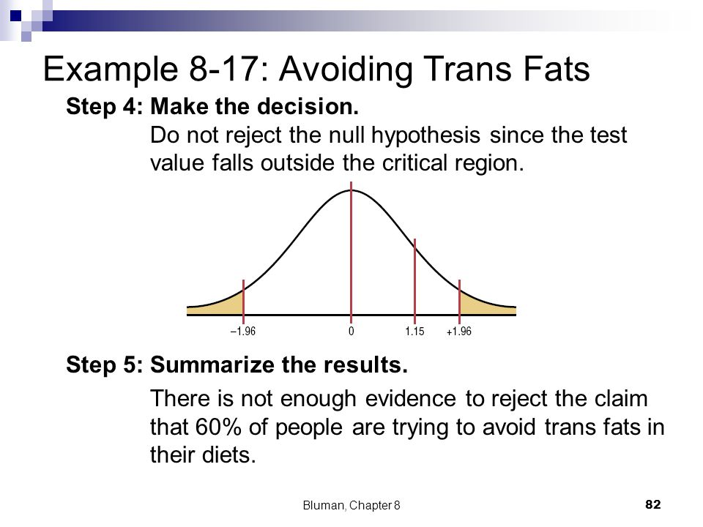

Slide 54
Hypothesis Testing: Z-test for Proportion (P-value Method)
An attorney claims that more than 25% of all lawyers advertise. A sample of 200 lawyers in a certain city showed that 63 had used some form of advertising. At α=0.05, is there enough evidence to support the attorney’s claim? Use p-value method.

Slide 55
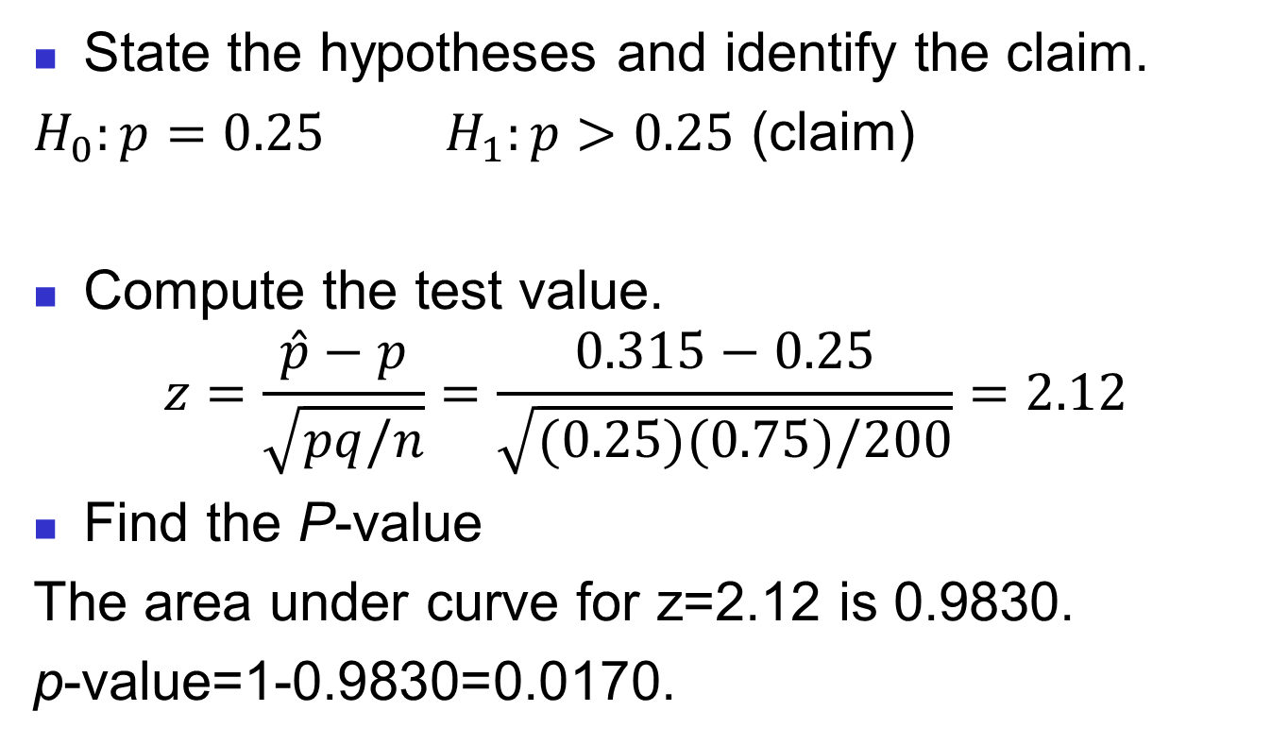
Hypothesis Testing Proportion (P-value Method)
State the hypotheses and identify the claim.
$H_{0}:p=0.25$ $H_{1}:p>0.25$ (claim)
Compute the test value.
$$z=\frac{\hat{p}−p}{\sqrt{pq/n}}=\frac{0.315−0.25}{\sqrt{(0.25)(0.75)/200}}=2.12$$
Find the P-value
The area under curve for z=2.12 is 0.9830.
p-value=1-0.9830=0.0170.

Slide 56
Decision: Reject null hypothesis since p-value=0.0170 < α=0.05.
Conclusion: There is enough evidence to support the attorney’s claim that more than 25% of the lawyers use some form of advertising.

Slide 57

Hypothesis Testing: Z-test for Proportion (Confidence Interval Method)
Formula :
$$\hat{p}−z_{\frac{α}{2}}\sqrt{\frac{\hat{p}\hat{q}}{n}}<p<\hat{p}+z_{α/2}\sqrt{\frac{\hat{p}\hat{q}}{n}}$$

Slide 58
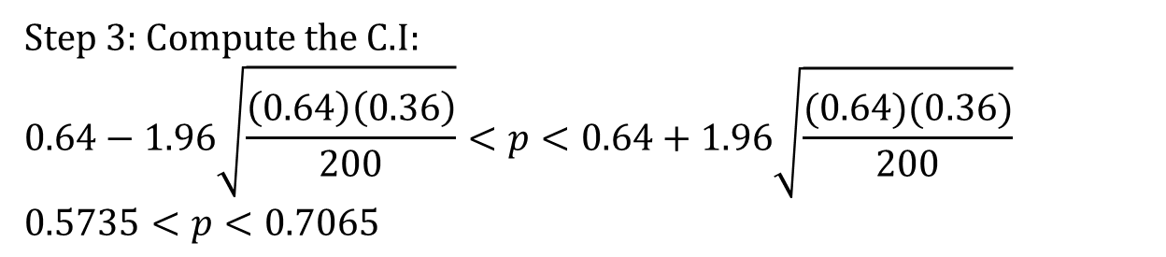
Using example in slide #48, find the 95% confidence interval.
Step 3: Compute the C.I:
$$0.64−1.96\sqrt{\frac{\left(0.64\right)\left(0.36\right)}{200}}<p<0.64+1.96\sqrt{\frac{(0.64)(0.36)}{200}}$$
$$0.5735<p<0.7065$$

Slide 59
Decision: The 95% C.I does contain the hypothesized mean. Do not reject the null hypothesis.
So, there is agreement between the hypothesis and the confidence interval.

Slide 60
THANK YOU

